Slide 1
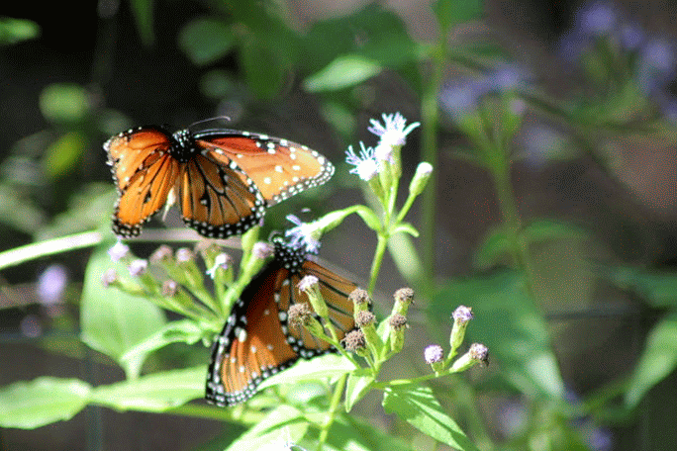
Butterfly mating Optimization Algorithm
By-
S. PAVANI (N150288)
M. Nagamani (n15045)
K. Vineetha (n150727)
g. Nagalaxmi (n150390)

Slide 2
Introduction:
Butterfly Mating Optimization is swarm intelligence based algorithm which gives solutions for Multimodal Optimization problems in which we need to find not only the best solutions but,also some of the other possible solutions using butterfly communication strategy.
Swarm Intelligence: In Nature many groups of organisms to gether achieve a specific task by their collective behavoiur like ant colony,butterfly mating,glowwarm swarm etc.,

Slide 3
Description of BMO Algorithm:-
While communicating using patrolling butterflies mainly use UV reflectance (by males) and absorbance (by females) mechanism for mating. This proposed “Butterfly Mating Optimization ” .
Assumes that there is no differentiation among males and females and every butterfly reflects UV it has got and absorbs UV that it receives from all the remaining butterflies simultaneously. Hence this algorithm suggests a meta –butterfly model which replaces “ Butterfly in the natural environment ” with “ Bfly bots in the search space ”.

Slide 4
AlGORITHM Phases:
Disperson
Random dispersion of Bflies
UV Updation Phase
Each Bfly updates its UV
UV Distribution Phase
Each Bfly distributes its UV to all Bflies
L-Mate Selection Phase
Chooses l-mate based on UV
Movement Phase
Move towards l-mate

Slide 5
UV UPDATION PHASE:
UVi(t)=max{0,b1*UVi(t-1)+b2*f(t)}
f(t) : fitness function
0<b1<1;
b2 >1;
UV is updated at time index ‘t’,
More importance to the current fitness and less to the previous UV,

Slide 6
UV Distribution Phase:
i^{th} Bfly having UV_{i} reflects it's UV value to the J^{th} Bfly at a distance d_{IJ} is given by d_{IJ}⁻¹
UV_{i→j}=UV_{i} *

Slide 7
L-Mate Selection Phase:
Bfly chooses another Bfly which has maximum UV as its L-mate which satisfies below condition i.e.,
UV(i^{th} Bfly) < UV(J^{th} Bfly)
i=1, 2, . . . , N;
J=1, 2, . . . , N-1;
J is index of Bflies in the descending order of i^{th} Bfly

Slide 8
Movement Phase :
Each Bfly is moved in the direction of its l-mate according to the equation:
x_{i}(t + 1) = x_{i}(t) + Bs *{ }
where Bs is Bfly step size;
xi(t) is the position of ith Bfly in a time index t.

Slide 9
BMO Pseudocode:-
Randomly initialize Bflies;
ᵾ i, set UVi =UV(0);
Set maximum number of iterations =iter_max and iter=1;
While (iter ≤ iter_max) do;
{ For each Bfly i do;
UV Updation ;
UV Distribution;
Select l-mate ;
Update position;
Iter=iter + 1 ;
}

Slide 10
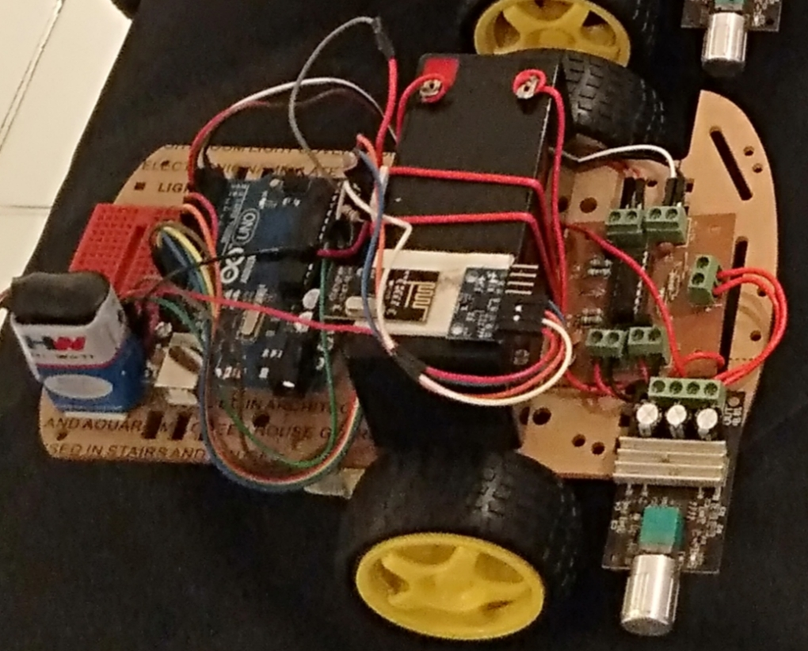
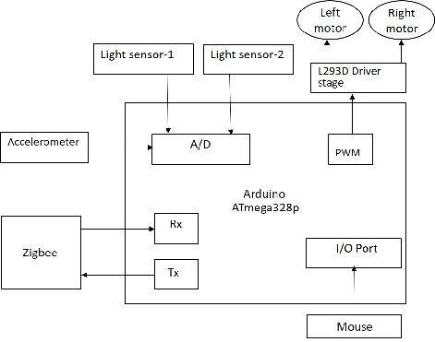
BFLYBOT: DESIGN AND ARCHITECTURE

Slide 11
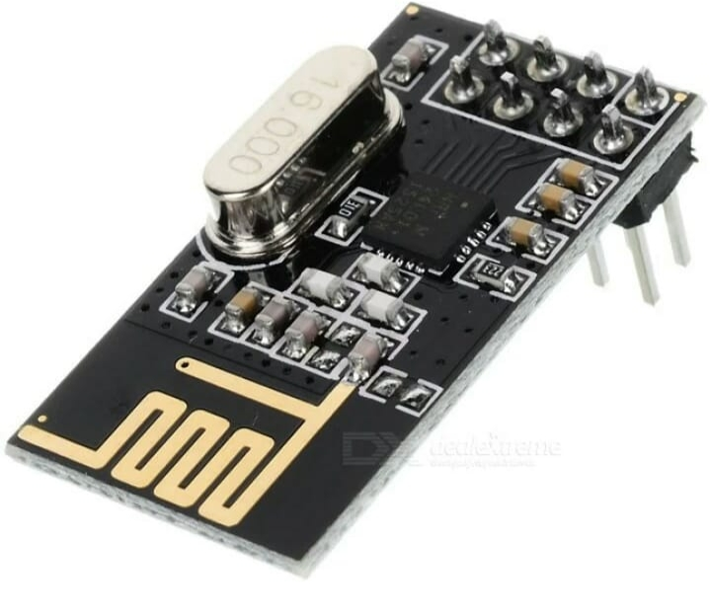
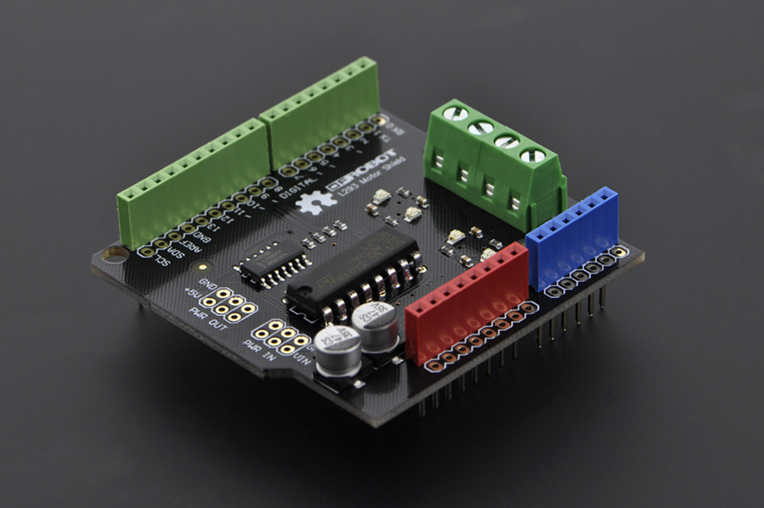
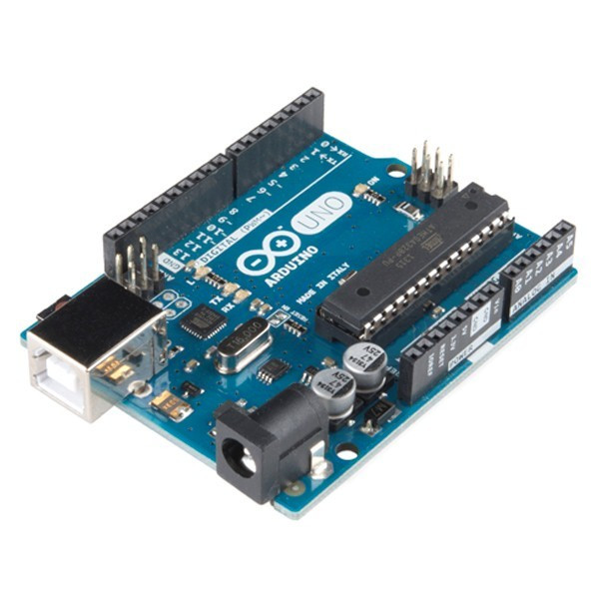
Components:
NRF Module
MOTOR SHEILD
ARDUINO UNO

Slide 12
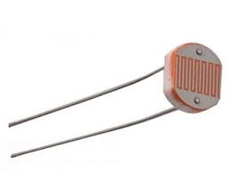

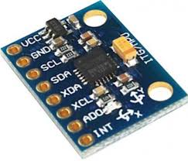
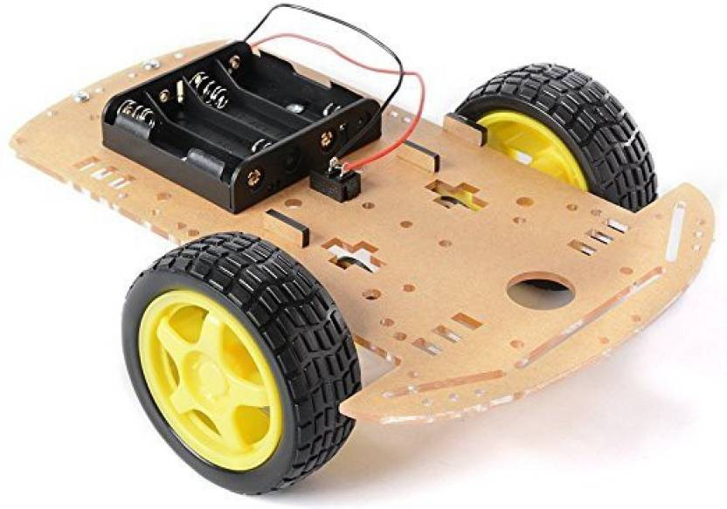
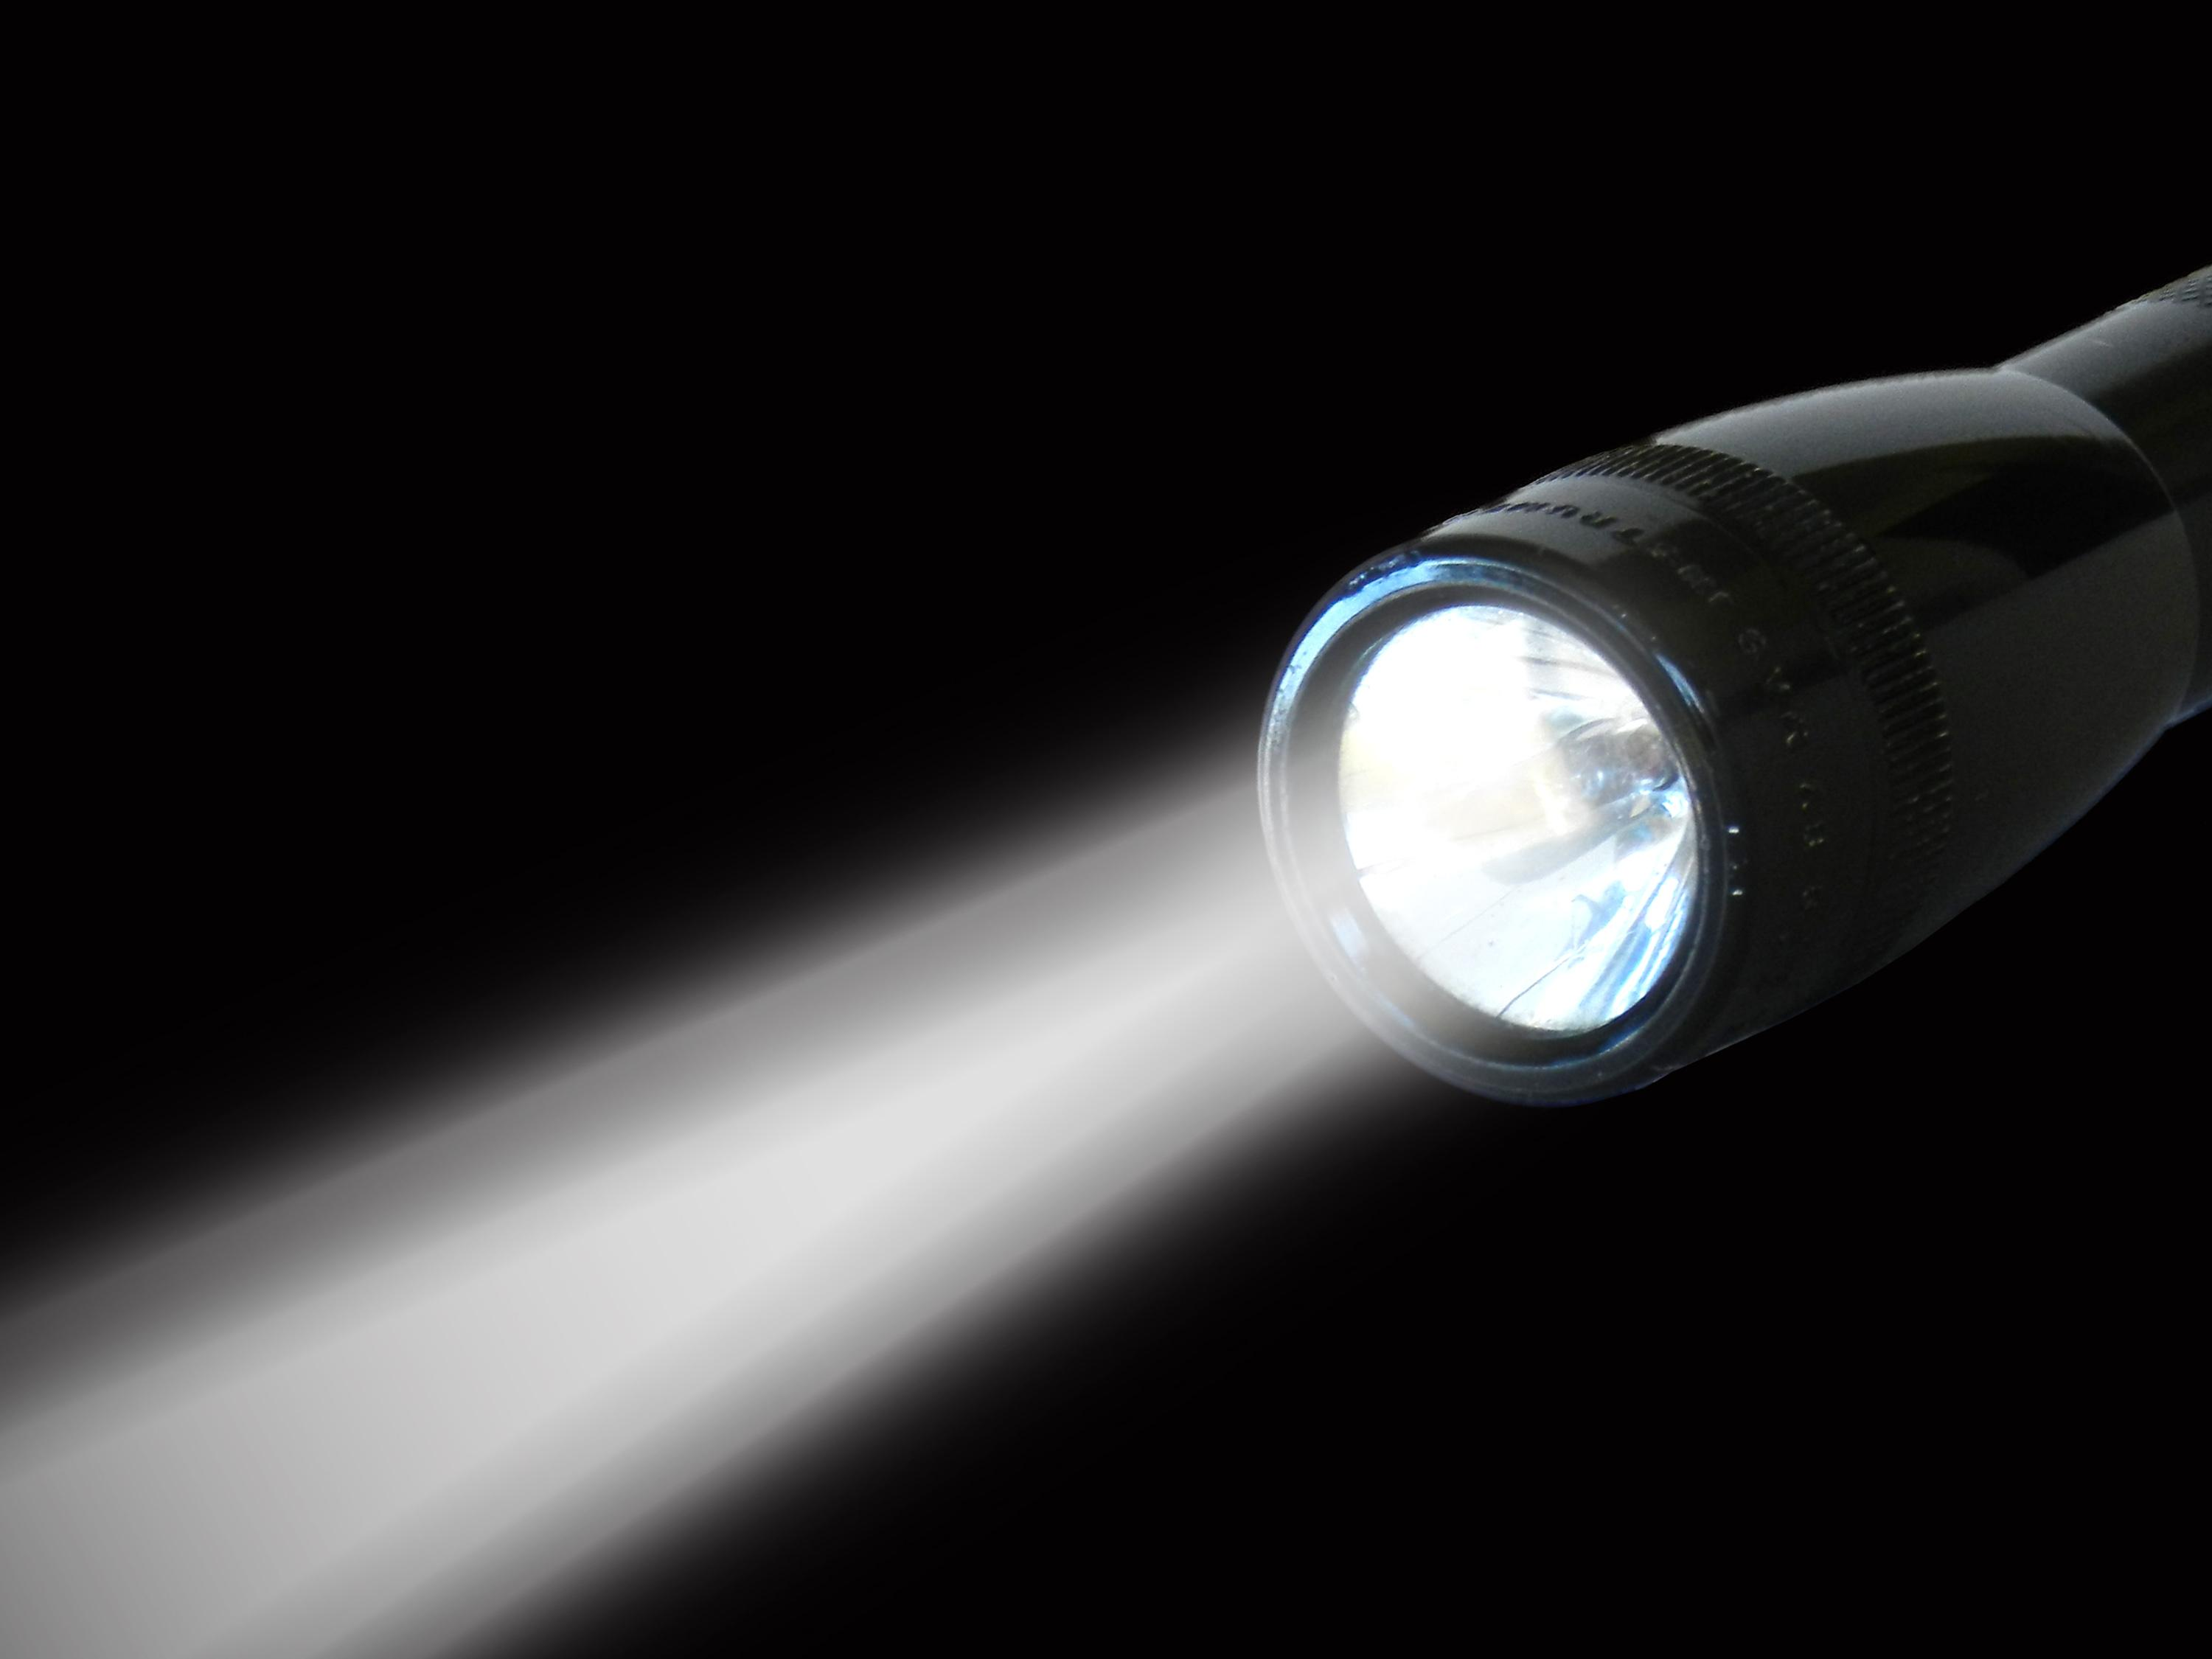
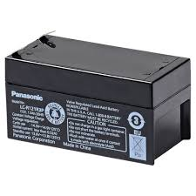
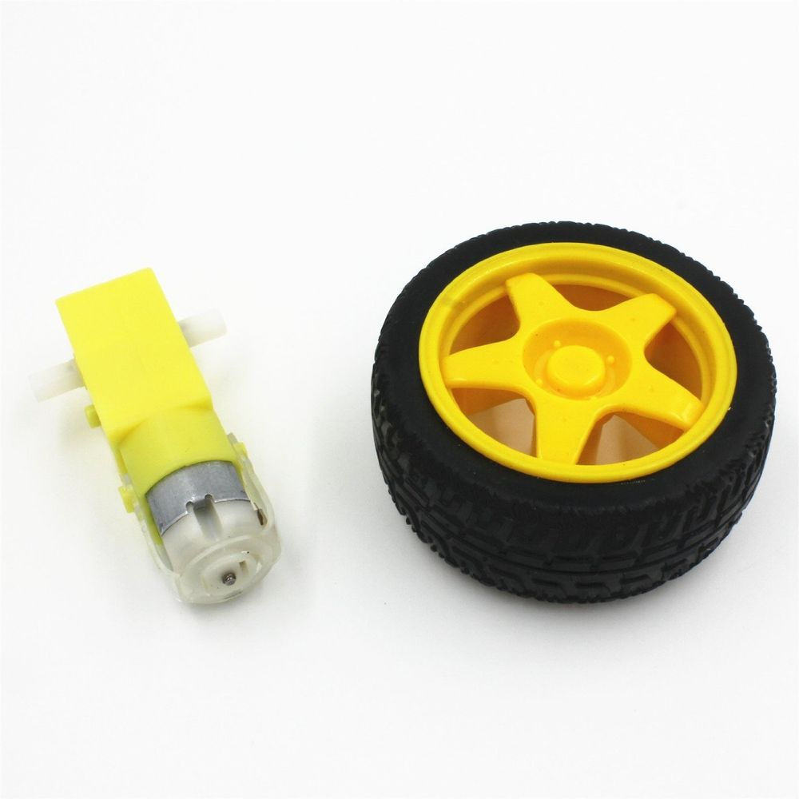
LDR sensor
PS2 Mouse
Gyro
Chasis
12V battery
Light Source
Motors&wheels

Slide 13
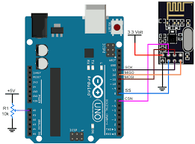
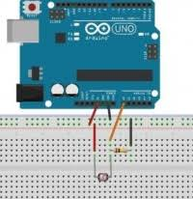
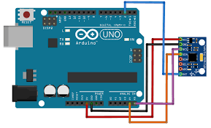
Interfacing the components with Arduino
LDR
GYRO
NRF Module

Slide 14
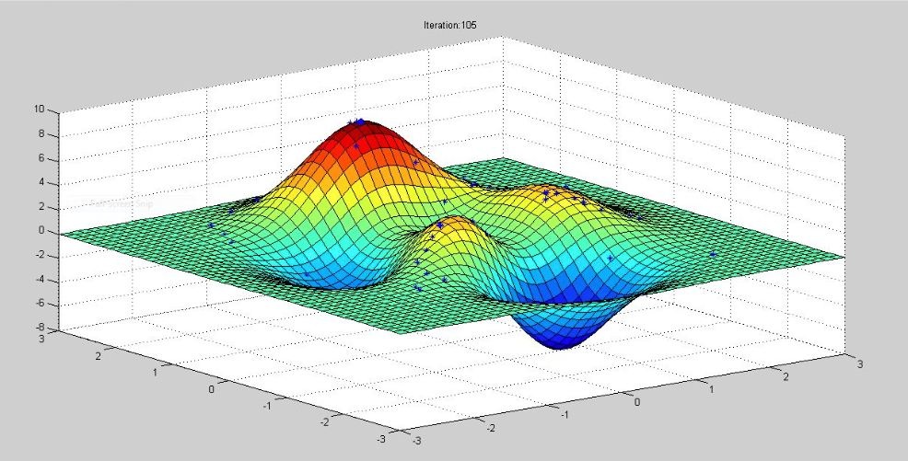
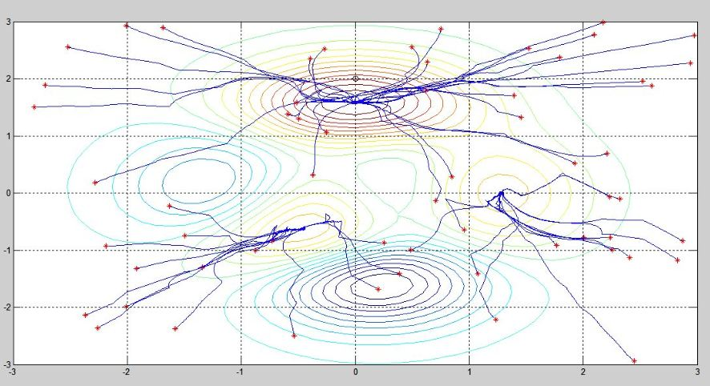
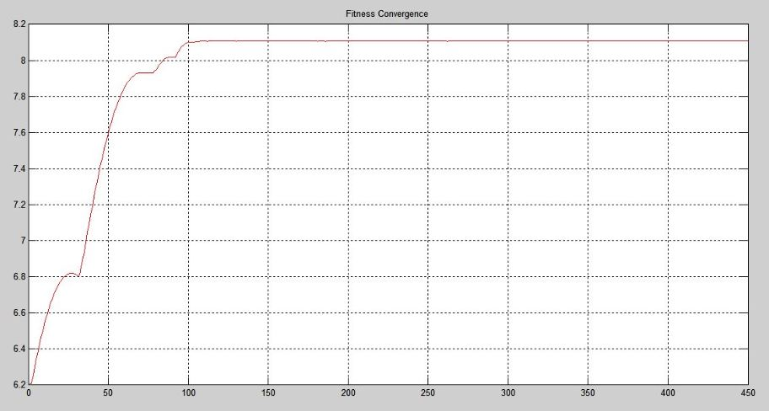
Simulation with 3 Peaks Function
Convergence plot
3D plot
Fitness Curve

Slide 15
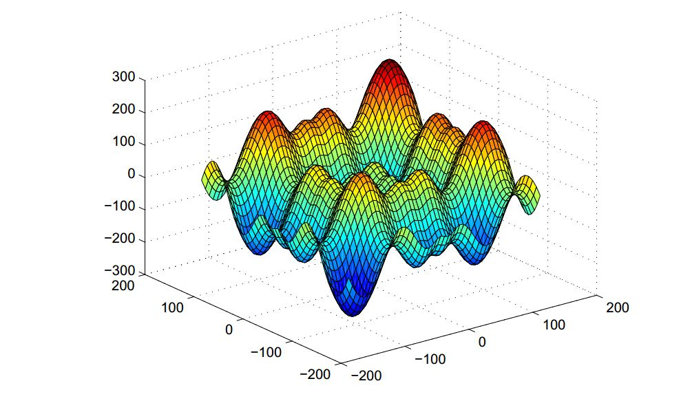
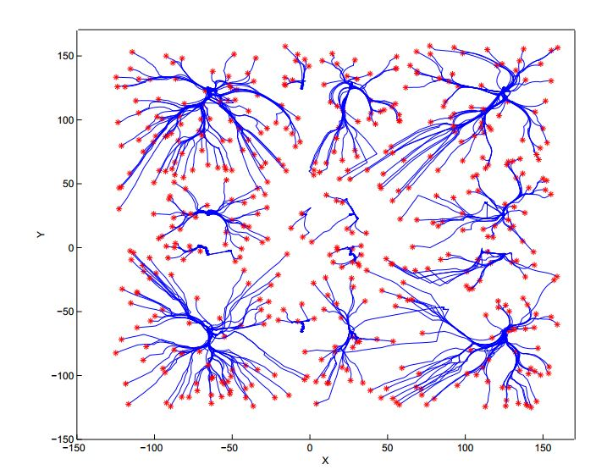
Scewful Function
3D Plot
Convergency Plot

Slide 16
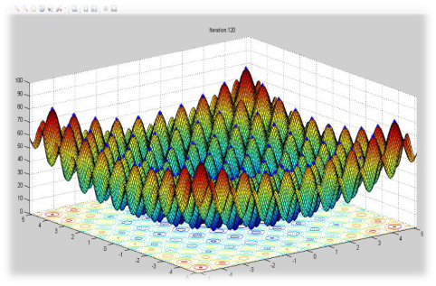
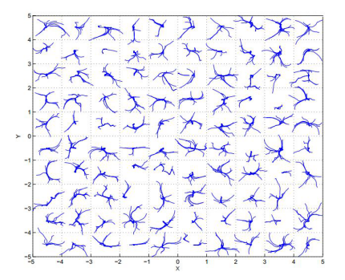
Rastrigin Function:
3D Plot
Convergency Plot

Slide 17
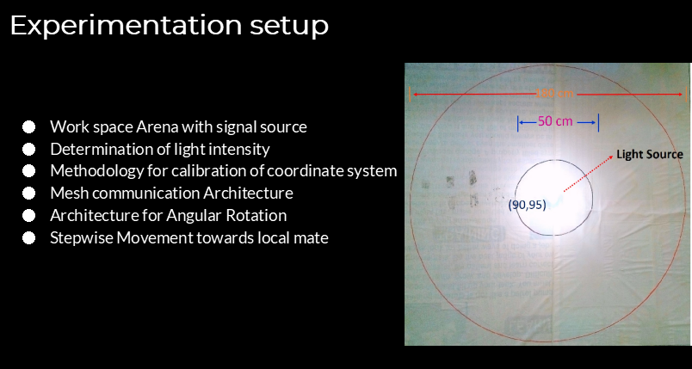

Slide 18
Applications of BMO:
In Synthesis and Structure Optimization of Antenna Arrays.
Disaster Management like Earth quakes
Industrial rescue operations
Ship Detection
Garbage Cleaning under oceans etc.

Slide 19
Thank You...

